Slide 1
Linear functions
Rate of Change and Slope
All slides in this presentations are based on the book Functions, Data and Models, S.P. Gordon and F. S Gordon ISBN 978-0-88385-767-0

Slide 2
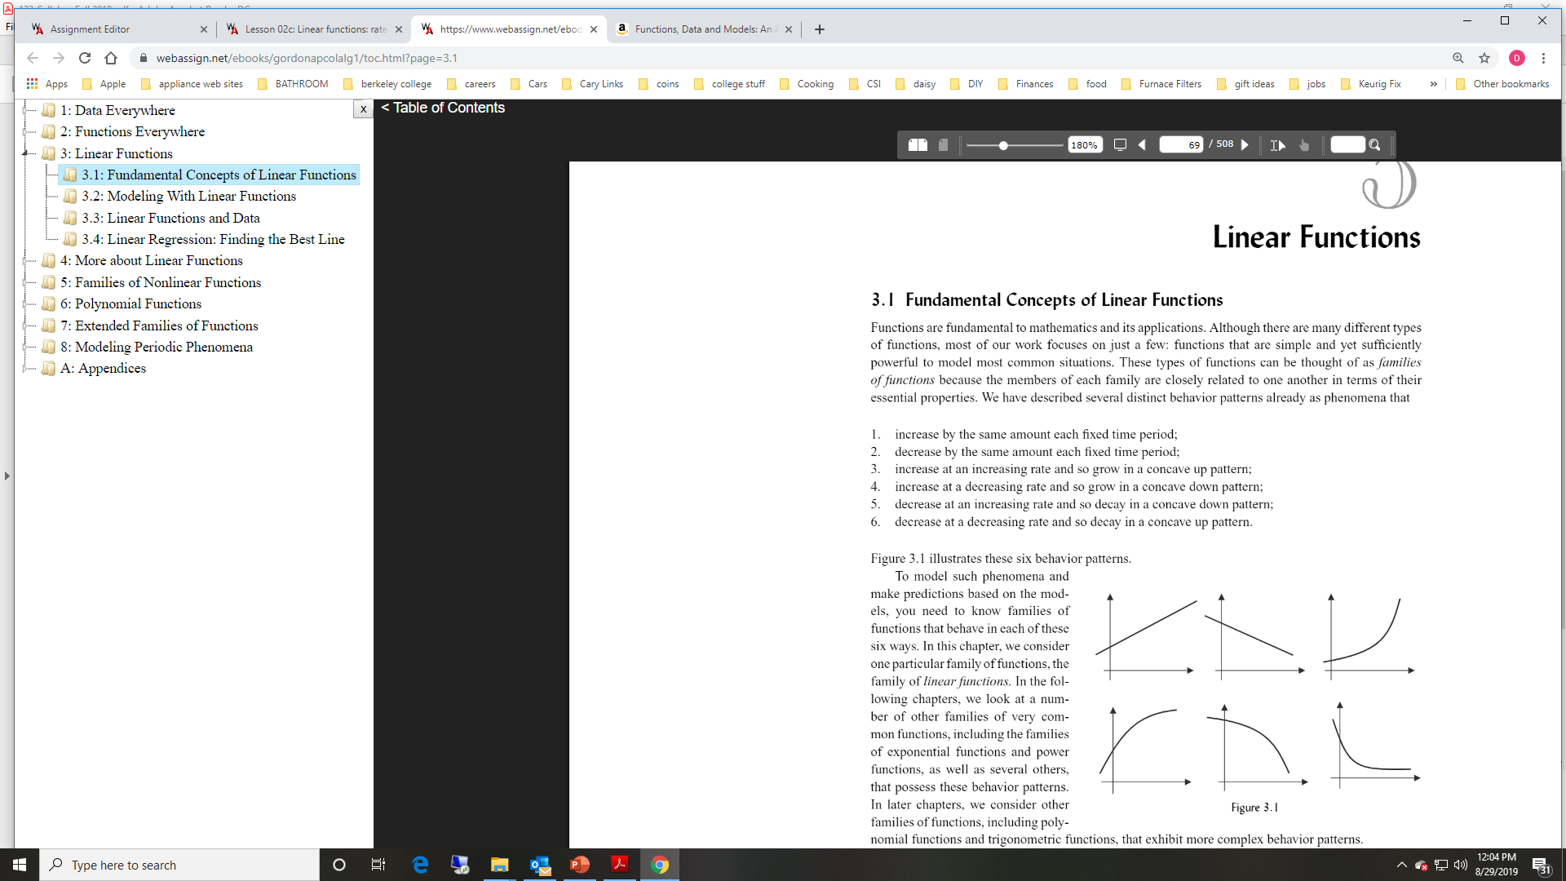
Review
Distinct behavioral patterns of functions studied thus far (see figure 3.1):
Increase by the same amount each fixed period.
Decrease by the same amount each fixed period.
Increase at an increasing rate and so grow in a concave up pattern.
Increase at a decreasing rate and so grow in a concave down pattern.
Decrease at an increasing rate and so decay in a concave down pattern.
Decrease at a decreasing rate and so decay in a concave up pattern.

Slide 3
Linear Functions
Simplest and most useful family of functions
The graph is always a straight line.
The equation of any linear function can be written in the form y = ax + b where a and b are any two constants
To understand linear functions we must know the effect each of the two numbers a and b in y = ax + b have on the corresponding line.

Slide 4
Linear Functions Passing through the Origin
Simplest type of linear function is of the form y = ax
This means y is proportional to x.
Ex.
The distance D that a car travels at a constant speed of 50 mph is proportional to the number of hours t driven.
Therefore, the number of miles traveled is : D = 50t

Slide 5
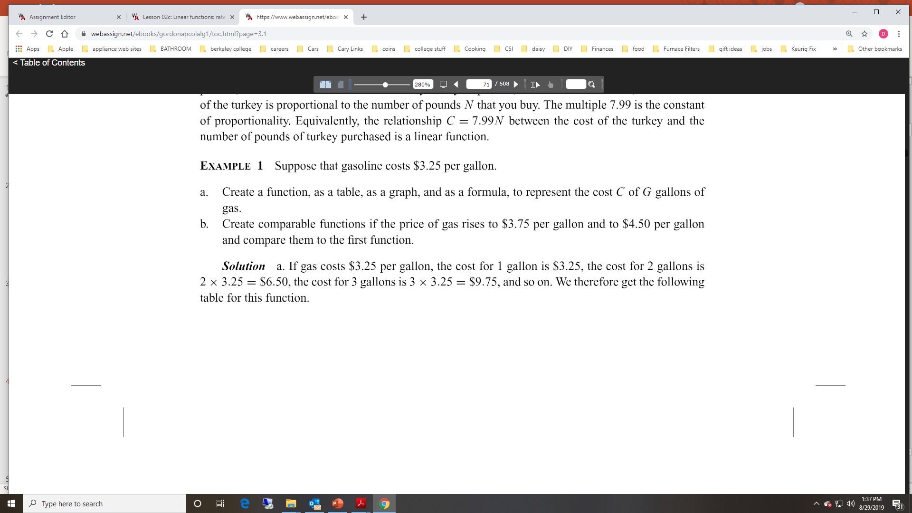
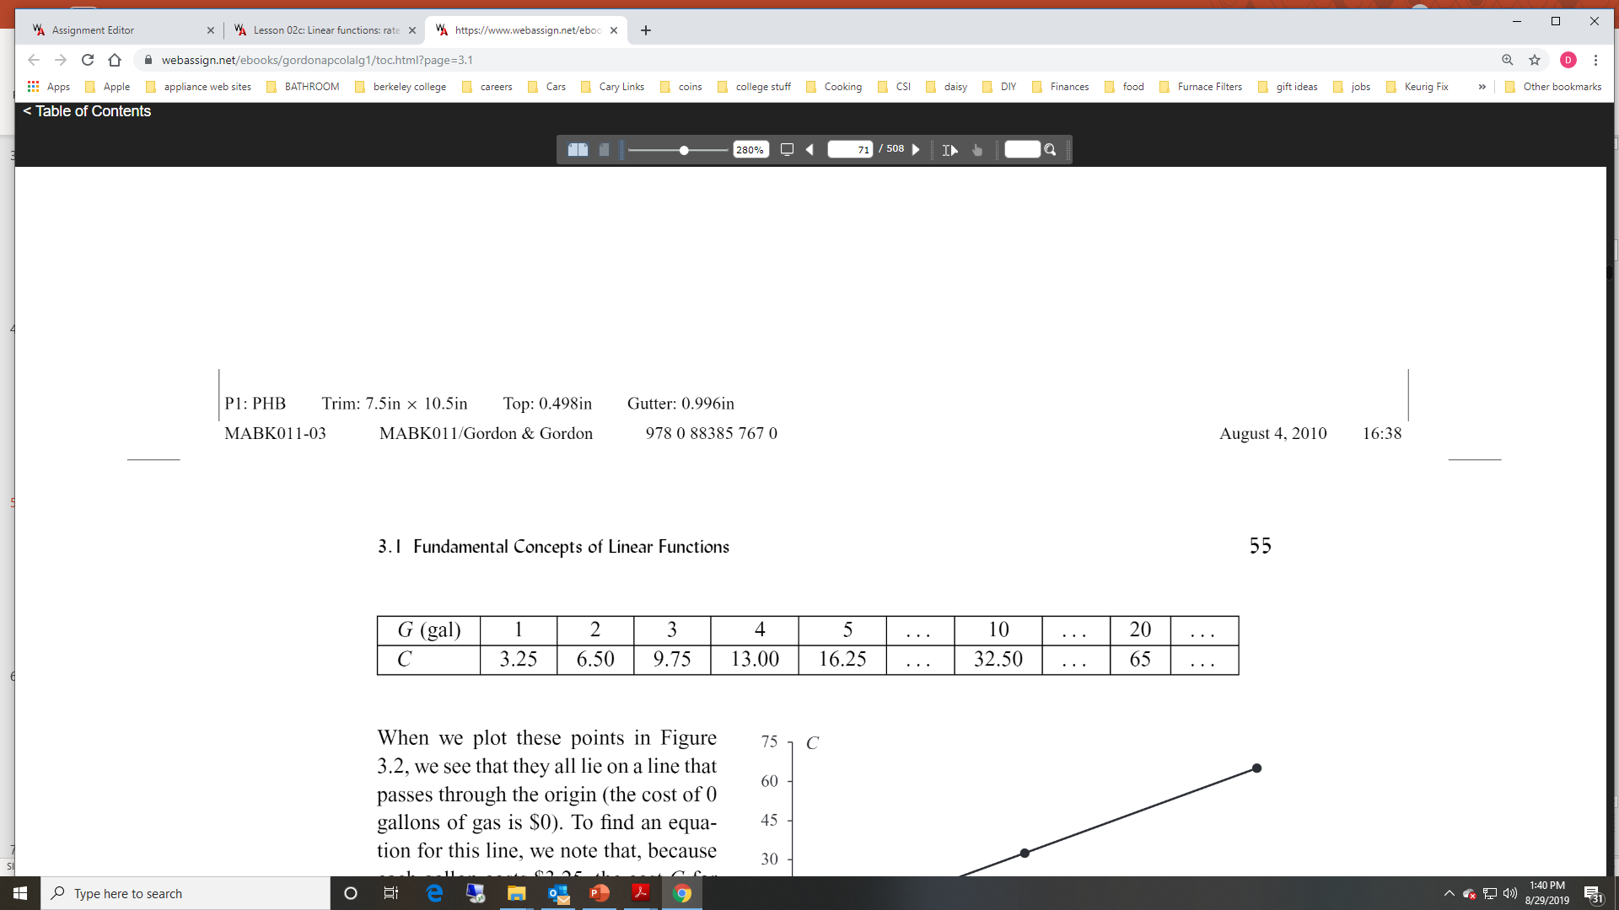
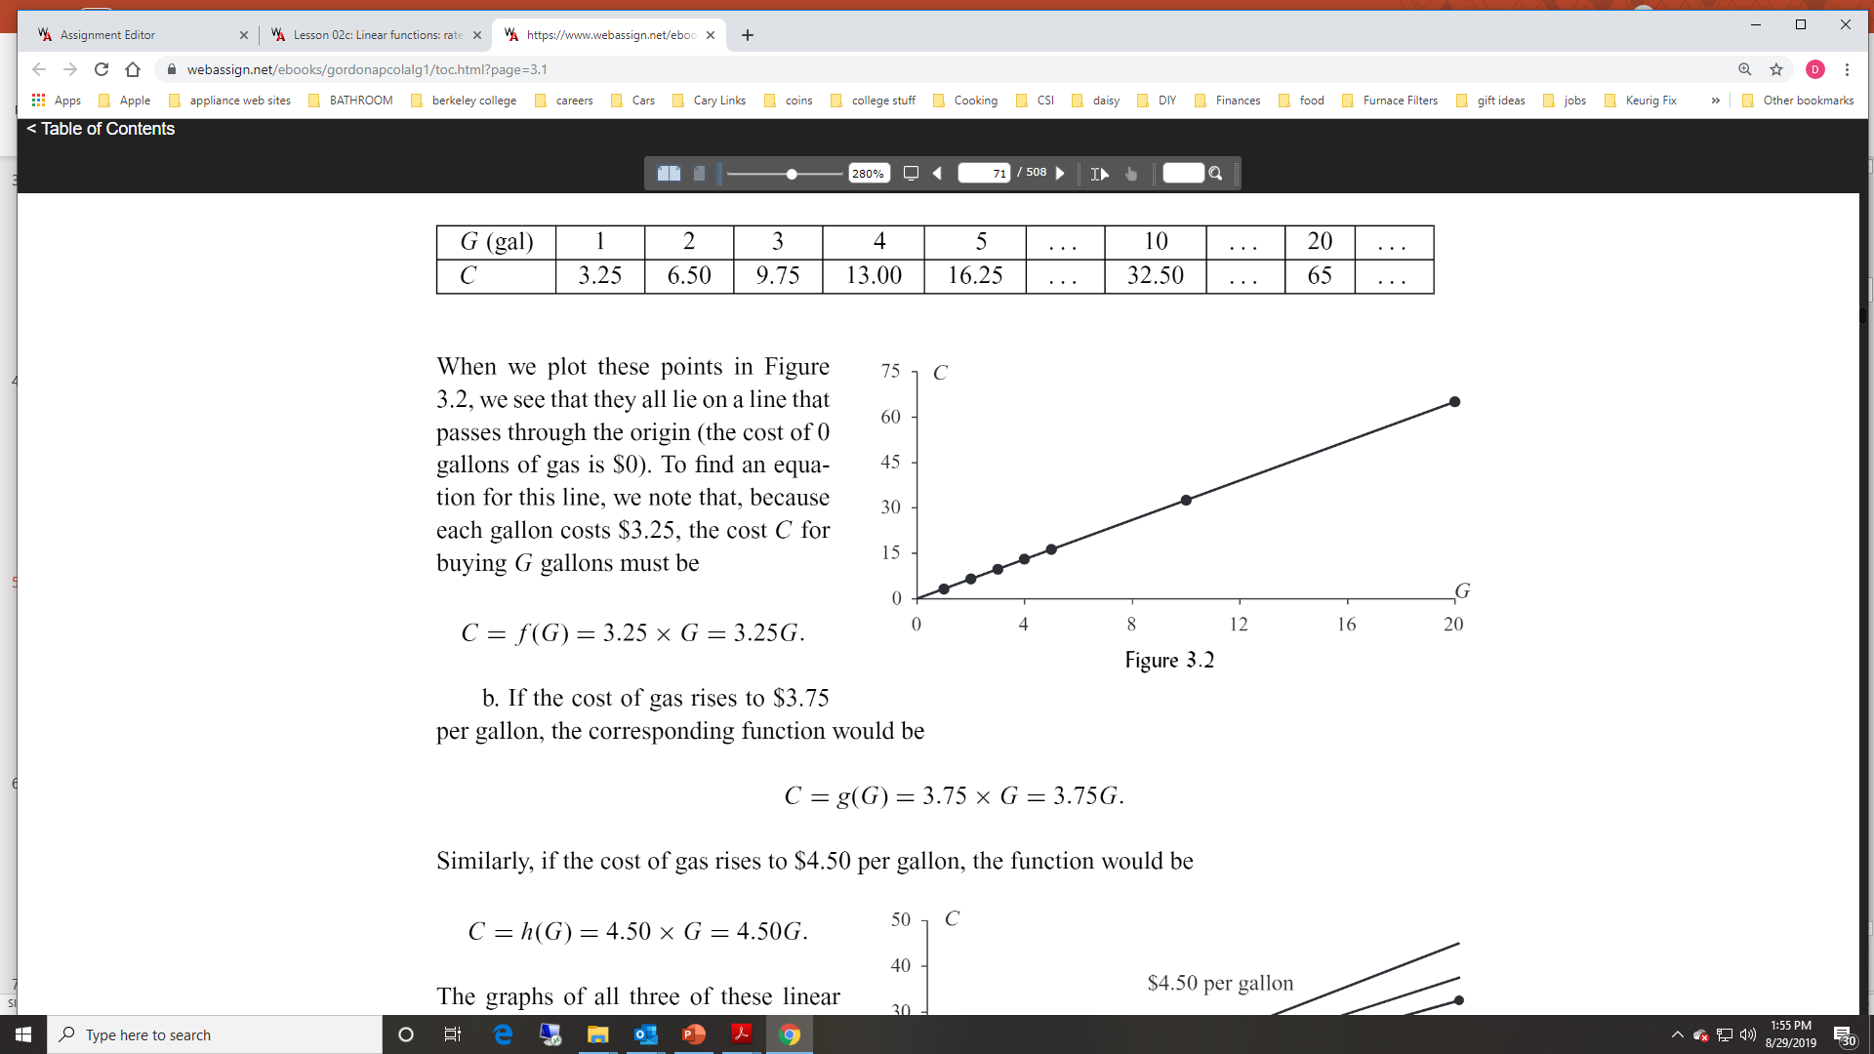
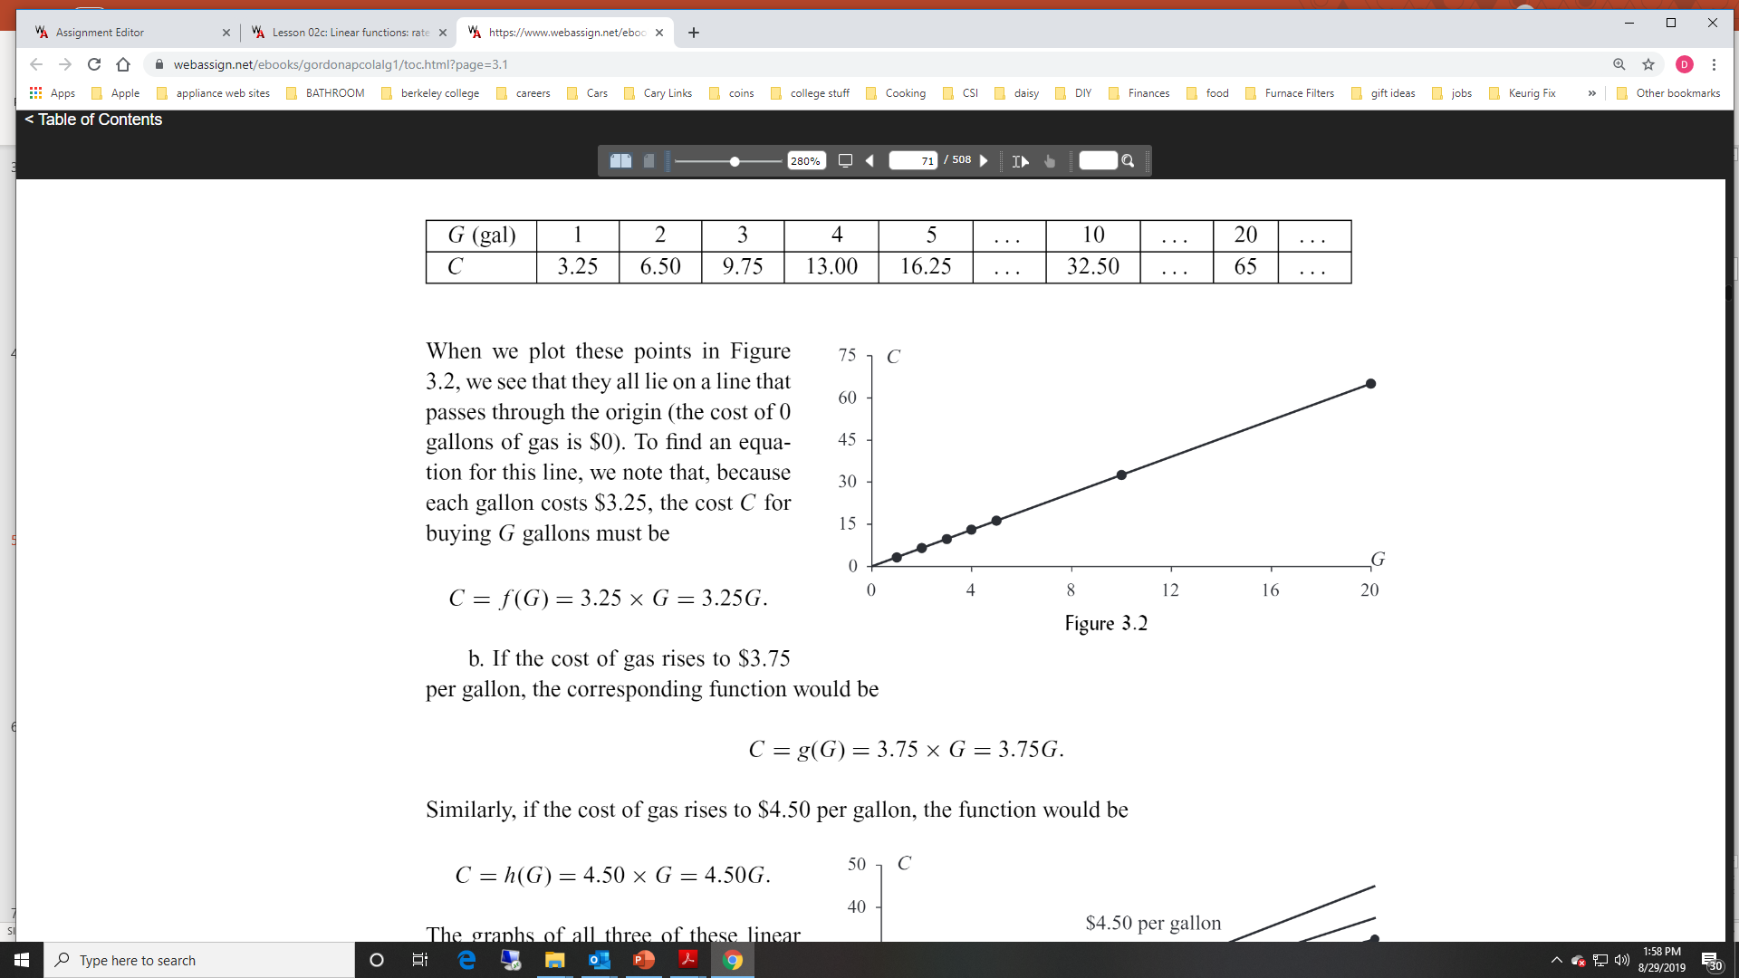
Example 1
Solution – part a
Table
Solution – part a
Graph
Solution – part a
Formula

Slide 6
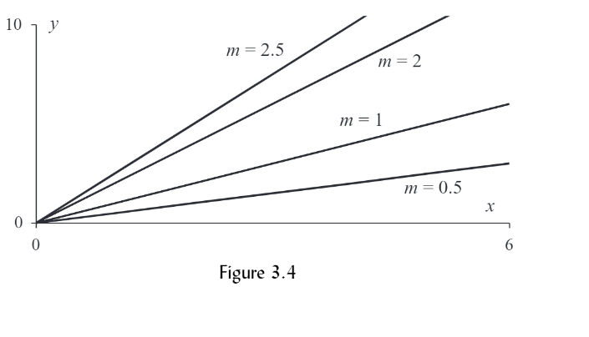
Slope of Linear Functions Passing through the Origin
Graph of the line y = mx for positive values of m (see figure 3.4)
As m gets larger, what happens to the line?
What if m = 0, what would the line look like?

Slide 7
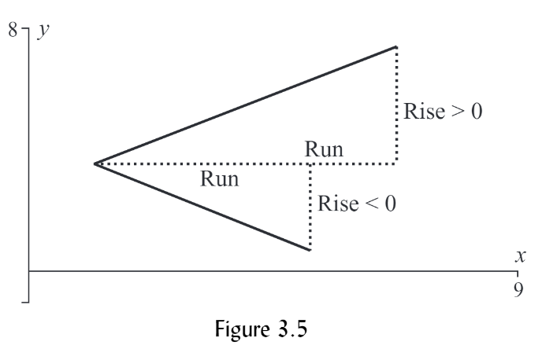
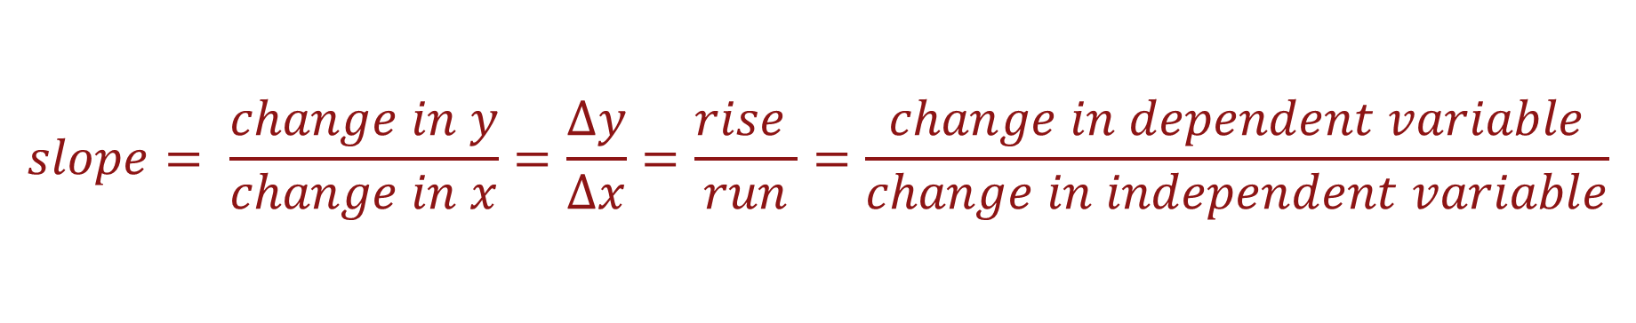
Definition of Slope
$$slope= \frac{change in y}{change in x}=\frac{∆y}{∆x}=\frac{rise }{run}=\frac{change in dependent variable}{change in independent variable}$$

Slide 8
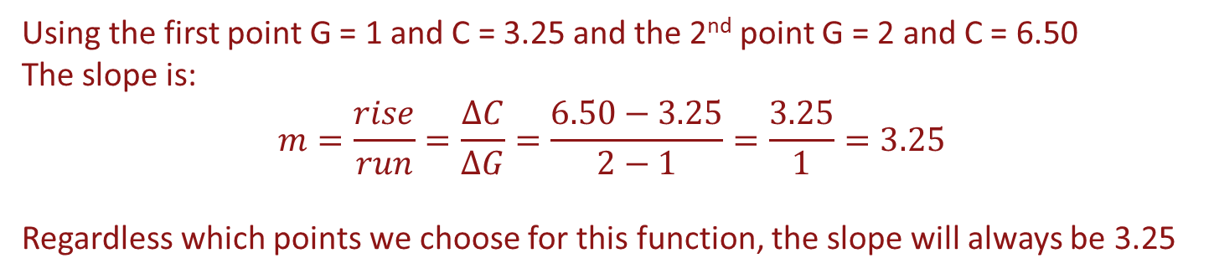
Slope Calculation
Here are the data from example 1
Using the first point G = 1 and C = 3.25 and the 2nd point G = 2 and C = 6.50
The slope is:
$$m=\frac{rise}{run}=\frac{∆C}{∆G}=\frac{6.50−3.25}{2−1}=\frac{3.25}{1}=3.25$$
Regardless which points we choose for this function, the slope will always be 3.25

Slide 9
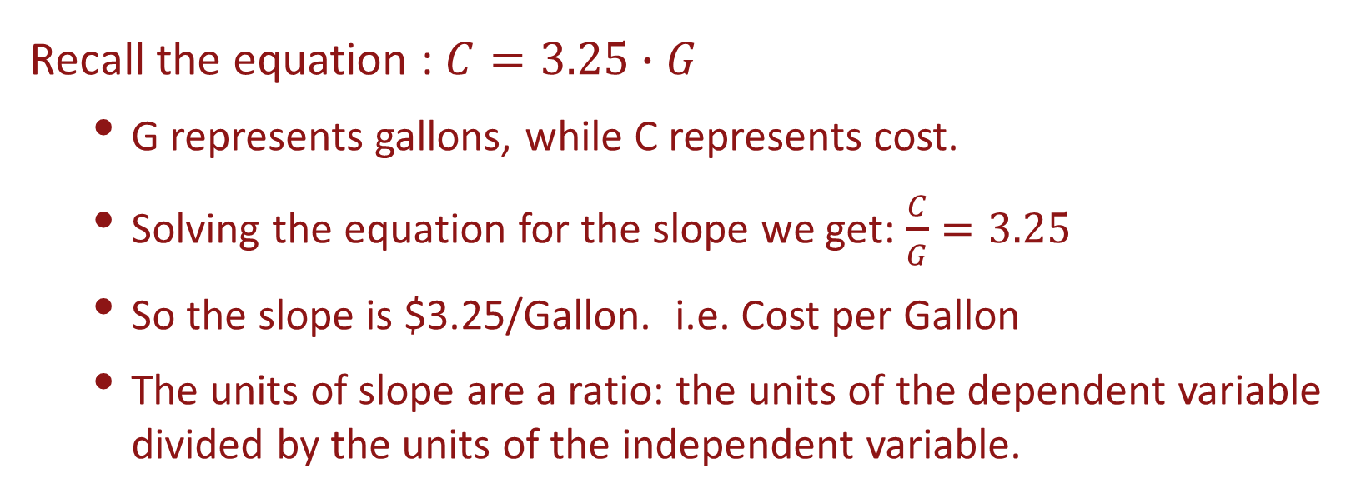
Slope Interpretation
Recall the equation : $C=3.25∙G$
G represents gallons, while C represents cost.
Solving the equation for the slope we get: $\frac{C}{G}=3.25$
So the slope is $3.25/Gallon. i.e. Cost per Gallon
The units of slope are a ratio: the units of the dependent variable divided by the units of the independent variable.

Slide 10
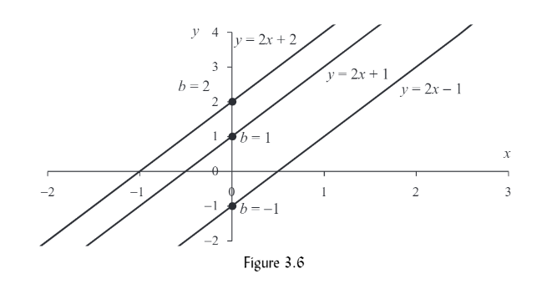
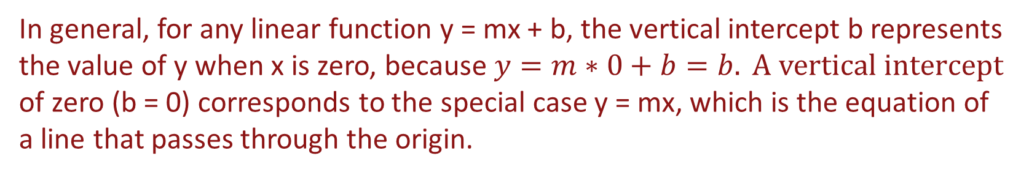
Lines That Don’t Pass through the Origin
Consider a line y = mx + b where m is the slope and b is a constant
Now let’s graph: (see figure 3.6)
y = f(x) = 2x – 1
Y = g(x) = 2x + 1
Y = h(x) = 2x + 2
The three lines are parallel
This occurs because the slope = 2 for each of the 3 lines.
Each line crosses the vertical axis at its value of b
We call b the vertical intercept.
In general, for any linear function y = mx + b, the vertical intercept b represents the value of y when x is zero, because $y=m∗0+b=b. A vertical intercept$ of zero (b = 0) corresponds to the special case y = mx, which is the equation of a line that passes through the origin.

Slide 11
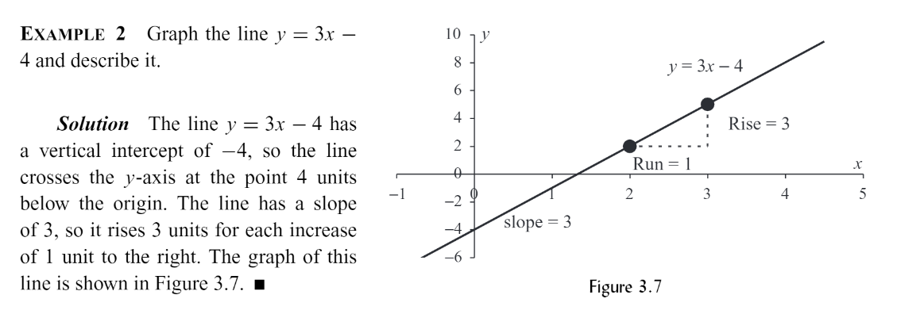
Example

Slide 12
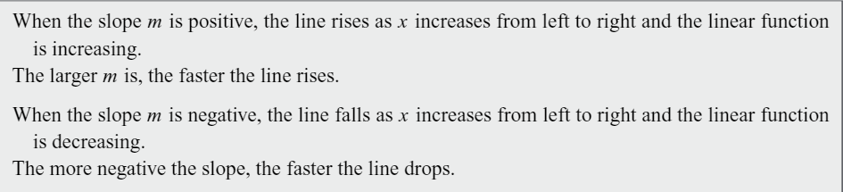
Slope Summary
www.desmos.com

Slide 13
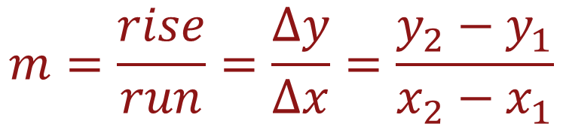


Example 2
$$m=\frac{rise}{run}=\frac{∆y}{∆x}=\frac{y_{2}−y_{1}}{x_{2}−x_{1}}$$
Example
An electronics distributor charges stores the following costs, C, in dollars for MP3 players depending on the number n of units ordered by a store.
n | 1 | 2 | 3 | 4 | 5
C | 90 | 170 | 250 | 330 | 410
$$⋯$$
$$⋯$$
Find the formula for the linear function that models the cost.
What is the practical meaning of the slope and the vertical intercept in this problem?
Suppose the distributor charged a customer $570. How many units did the store order?
$$⋯$$
$$⋯$$

Slide 14
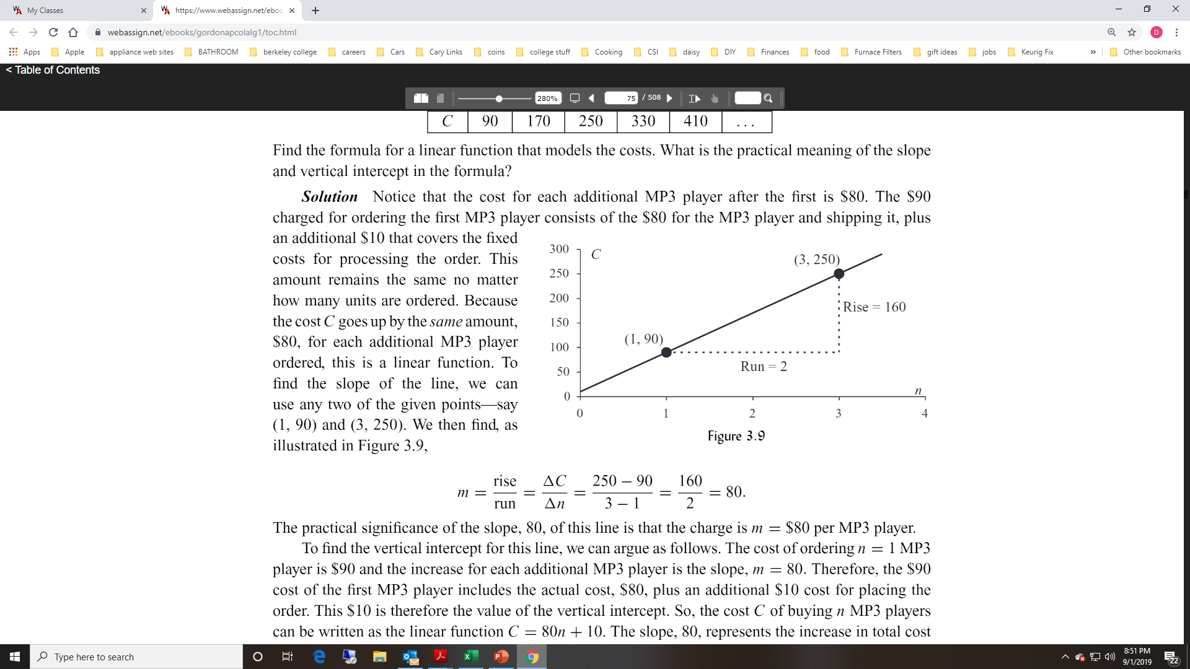
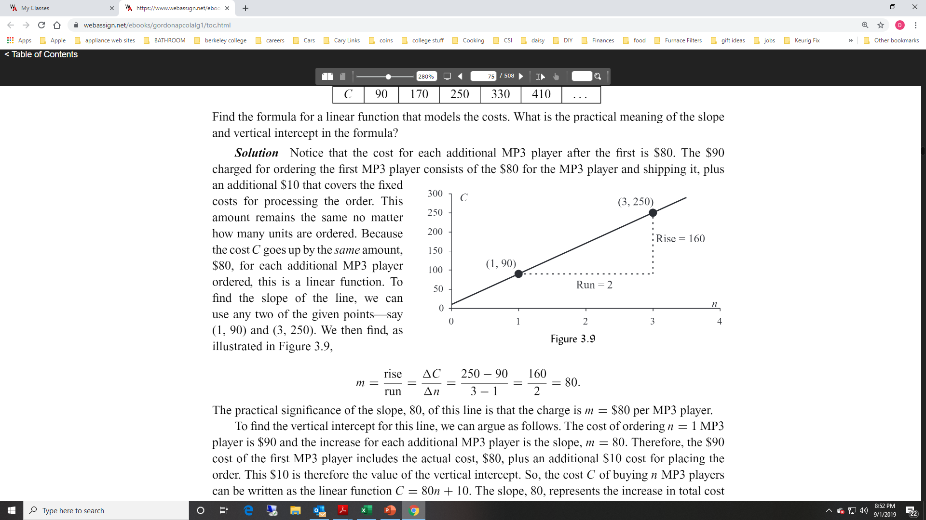
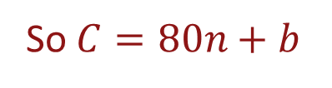

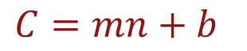

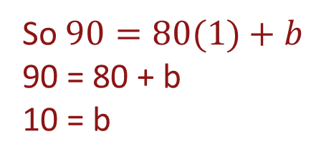
Example 2 Solution
n | 1 | 2 | 3 | 4 | 5
C | 90 | 170 | 250 | 330 | 410
$$⋯$$
$$⋯$$
$C=mn+b$
So the equation is C = 80n + 10 (Slope – Intercept Form)
The slope 80 represents the increase in the total cost for each additional unit ordered.
The vertical intercept, 10, is the fixed cost for any size order.
So $C=80n+b$
Choose the point (1, 90)
So $90=80(1)+b$
90 = 80 + b
10 = b
$$⋯$$
$$⋯$$

Slide 15
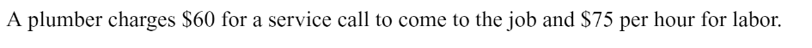
Example 3
Using the slope – intercept form, find a linear function for the plumber’s charges, C, for a job taking t hours (ignoring the costs of any parts).
What is the practical significance of the slope?

Slide 16
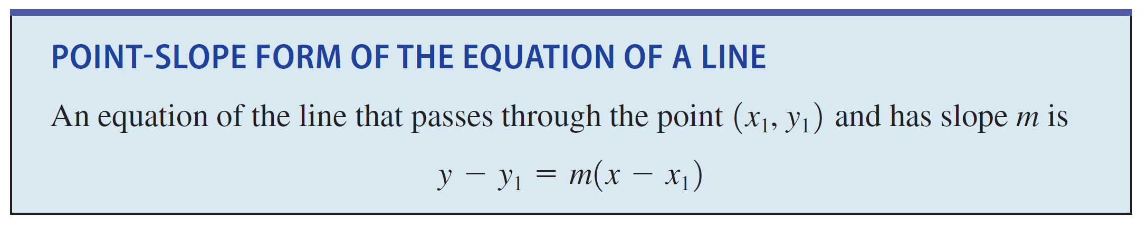
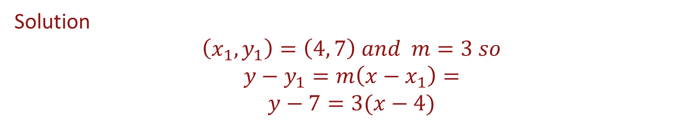
Point-Slope Form of the Equation of a Line
Ex.
Find the equation of the line through the point (4, 7) having a slope of 3.
Solution
$$\left(x_{1},y_{1}\right)=\left(4, 7\right) and m=3 so$$
$$y−y_{1}=m\left(x−x_{1}\right)=$$
$$y−7=3(x−4)$$

Slide 17
Example
Find the equation of the line through the points (2, 24) and (6,4). (notice we do not have the slope!)
Find the equation of the line through the points (6, 3) and (-2,3).

Slide 18
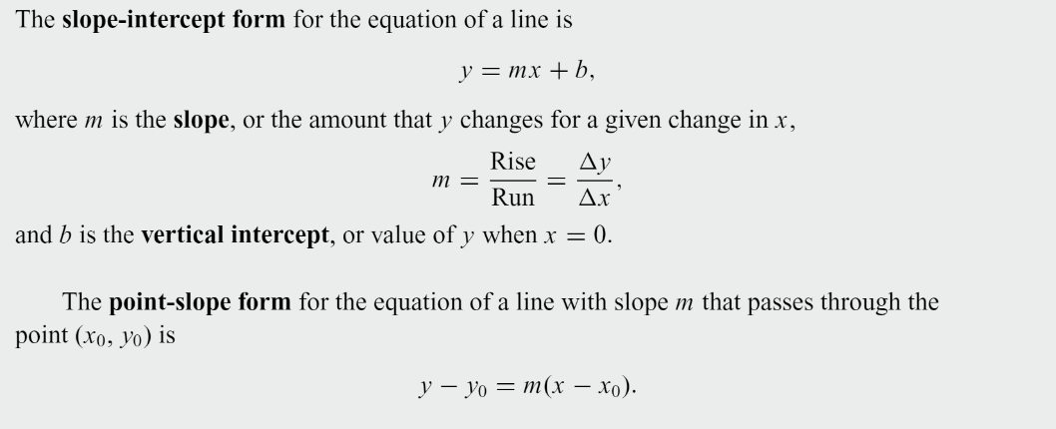
Summary

